Slide 1
Welcome!
Please, have a seat.
CWRU Quants
quants@case.edu
Notes:
CHristo

Slide 2
AGENDA
Research Vertical Updates
Intro to Exotic Options
Examples of Exotic Options
Live example
[ risks of exotic options and modeling ]
Notes:
Christo

Slide 3
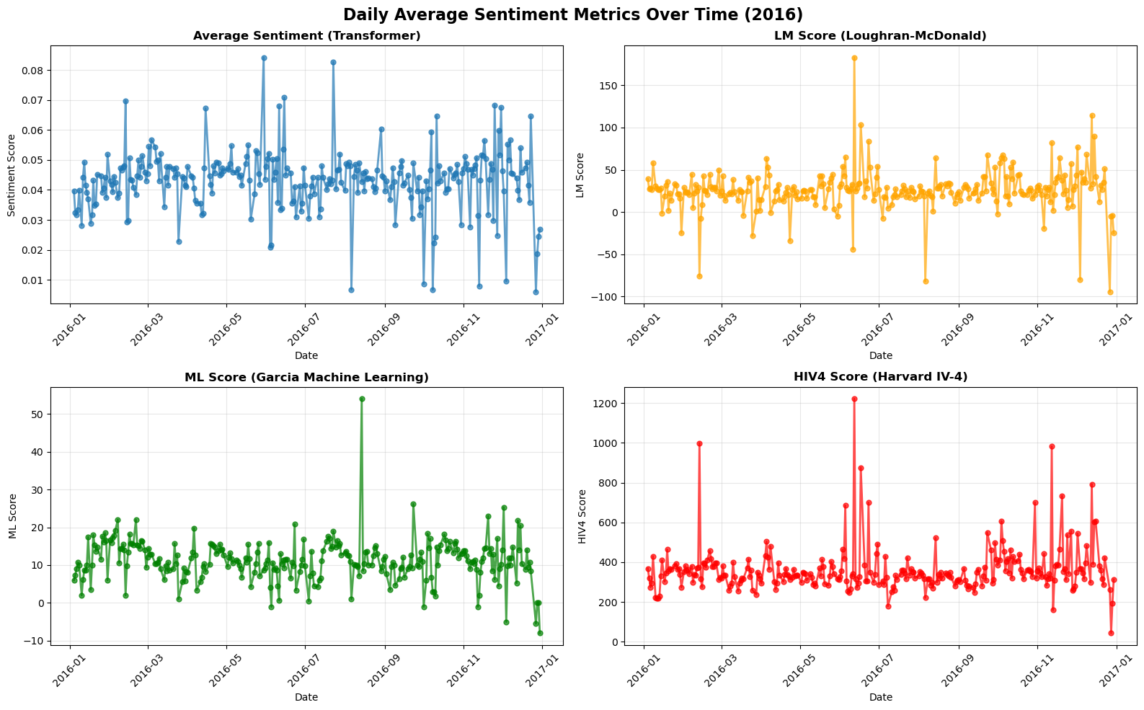

Slide 4
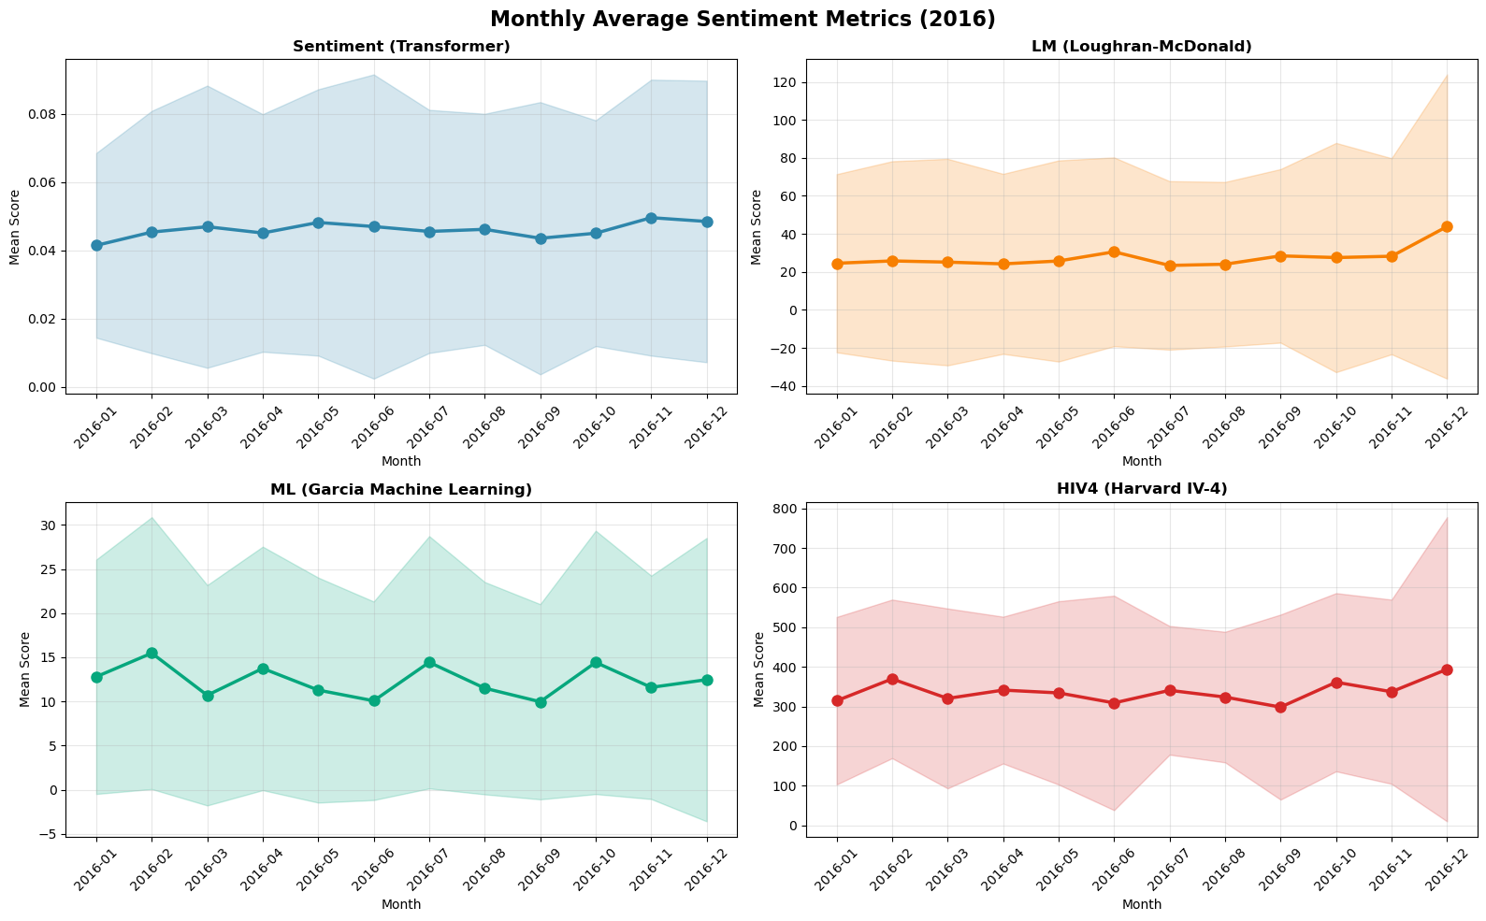

Slide 5
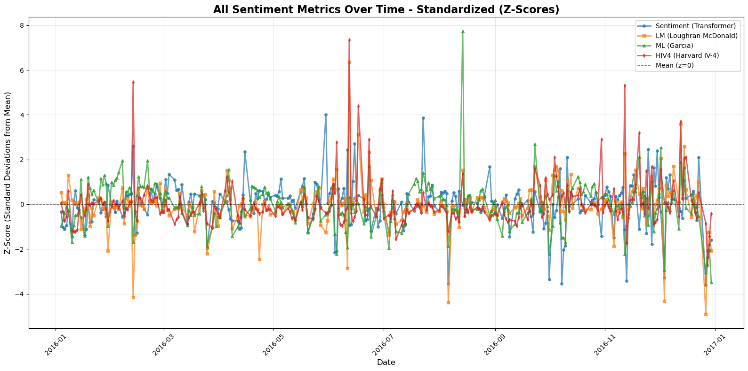

Slide 6
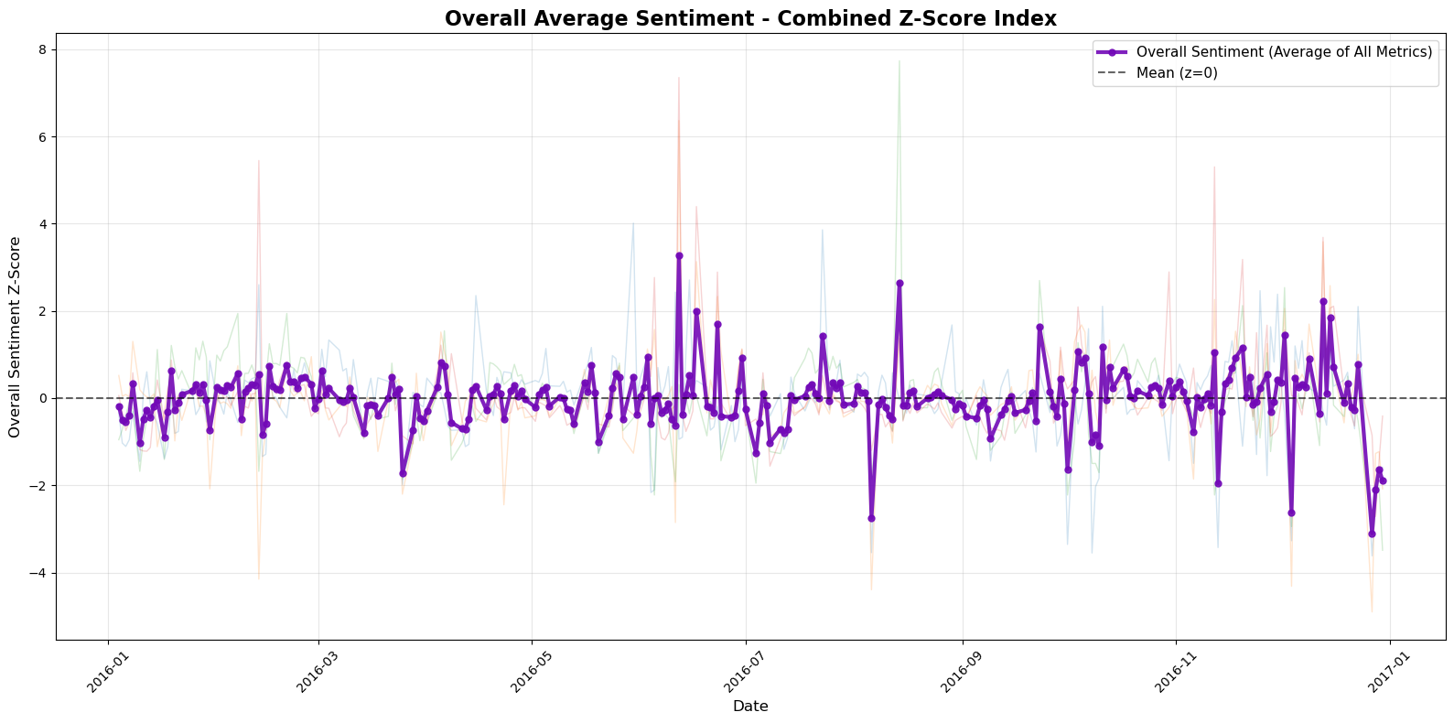

Slide 7
What’s next?
2016 was sort of a normal year for the market
Running on 2018 and 2020 transcripts
  2018: major tech companies like Square and Nvidia fell around 50%, due to trade fears with slowing Chinese economy, Fed raising interest rates, and people worried about a late 2019 economic crash
  2020: Covid, v-shaped recovery, tech boom, major players like Zoom, Teledoc Health, etc.
Keyword analysis:
  risk, politics, trade, etc.

Slide 8
Intro to Exotics
Notes:
Christo

Slide 9
American and European options
Review: What is the difference between American and European options?
Exotics are hybrids of American and European options and often fall somewhere between them. (Catch all term for anything that isn’t a traditional put/call)

Slide 10
But why?
Exotic options are traded in the over-the-counter market, rather than major exchanges like the New York Stock Exchange (NYSE).
they are typically customized to whatever the buy/seller needs for their portfolio
  specific commodities such as corn, oil, natural gas, equities, bonds, etc.
  forex options
  probably some crypto options

Slide 11
But why?
Pros | Cons
can be customized to meet the risk tolerance and desired profit of the investor exotic options can help offset risk in portfolio | some exotics do not guarantee profit since they are more complicated, reaction of price moves to market events can be different than traditional options

Slide 12
Examples of Exotic Options
Notes:
Christo

Slide 13
Path Dependent vs. Path Independent
Path Independent: If the value of the option only depends on final price of the underlying asset.
  These are like the “vanilla” American and European options we’ve looked at before.
Path Dependent: Value of the option is determined using prices leading up to and possibly including the final price of the option

Slide 14
Lookback Options
These are path dependent options that allow you to “look back” to the optimal value of the option and exercise the option with that price (max/min).
This is incredibly powerful since they give you the power of hindsight in financial markets.
  Because of this, the premiums are very high which factors in when considering profitable trades.
They also have floating/fixed strike price variants.
  Fixed: Have a strike price, then pick max/min to buy/sell at.
  Floating: Strike price is the max/min where then you take time at expiry like in vanilla options.

Slide 15
Payoffs For Lookback Options
Floating Strike Call and Put
Fixed Strike Call and Put

Slide 16
Rainbow/Basket Options
Catch all term for a Call or Put on the “best/worst of n underlying assets”
Ex: Take FTSE 100, Nikkei, and S&P 500; we then pay off the difference between the strike price and the index which has risen the most.
Can also “weight” the above at, say, 50%, 30%, and 20%, these are called Basket options.

Slide 17
Asian Options
Payoff is determined by the average of the underlying price over a period of time. *Path Dependent
Typically the arithmetic mean but can be geometric.
We can have Asian American and Asian European options, their definitions do not restrict each other.

Slide 18
Bermuda-Style Options
Somewhat of a middle ground between American and European options, they allow for discrete execution times.
You buy the option, and for example, at the end of each quarter you have the opportunity to exercise that option.
Canary-Style Options
Again a middle ground between Bermuda and European options
Allows for the holder to exercise the option at regular intervals (Bermuda), but only after some period of time has past (usually a year with quarterly Bermuda intervals)

Slide 19
Example
Notes:
Christo

Slide 20
Bob owns equity shares in Apple. He bought Apple at $150 per share, and wants to protect the position in case AAPL falls.
Bob buys a Bermuda-style put option that expires in three months, with a strike price of $150. The option premium costs $2, or $200, since one option contract equals 100 shares.

Slide 21
The option protects the stock position from a decrease in price below $150 for the next 3 months. However, this Bermuda option has an exotic feature, allowing the investor to exercise early on the first of each month until expiry.

Slide 22
Risks of Exotics
Notes:
Christo

Slide 23
Liquidity Risk
Exotic options are often OTC contracts rather than exchange traded, meaning few buyers and sellers, making it hard to exit or hedge positions before expiration.
Wide bid-ask spreads and lack of secondary markets increase costs.

Slide 24
Regulatory Risk
Exotic options are often OTC contracts rather than exchange traded, meaning few buyers and sellers, making it hard to exit or hedge positions before expiration.
Wide bid-ask spreads and lack of secondary markets increase costs.

Slide 25



Social Links
@cwruquants
@cwruquants
@cwruquants
Notes:
CHristo

Slide 26
QUESTIONS
AND ANSWERS
Contact us!
Email: quants@case.edu
Instagram: @cwruquants
Notes:
Sid

